Slide 1
Lecture 3
Brandon Moe

Slide 2
Todays Lesson
The RoboRio
The Radio
Parts of a robot
What they mean to you

Slide 3
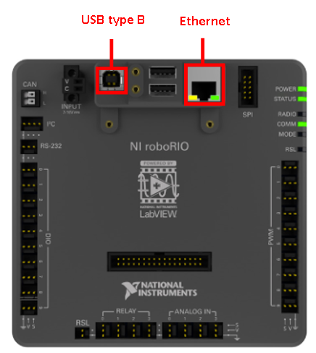
RoboRio

Slide 4
What is it?
The computer on the robot
Processes your code and executes it.
Fun fact: runs on NI Linux Operating System

Slide 5
Facts about the RoboRio
2 CPU
IP Address: 172.22.11.2
If connected to robot you can use 10.30.26.2
Connect through router, Ethernet to Rio, or USB B
Runs on 24 Volts

Slide 6
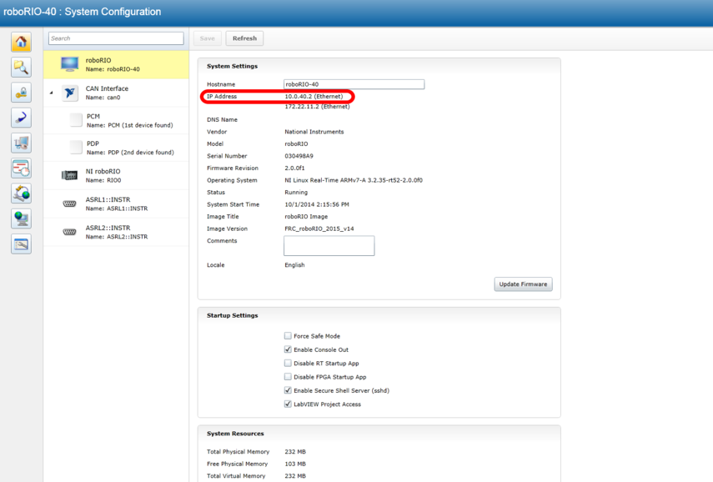
RoboRio Web Interface

Slide 7
Walk through of interface

Slide 8
IP Addresses to Know
Your PC: 10.30.26.5
UP Board 1: 10.30.26.11
UP Board 2: 10.30.26.12
RoboRio: 10.30.26.2
172.22.11.2 if not connected to wifi with code

Slide 9
Steps for brand new Rio
Image the Rio using the FRC imaging tool
Set Team Number to 3026
Set the IP Address to static on web interface
IP address: 10.30.26.2
Subnet Mask: 255.0.0.0
Gateway: 10.30.26.1
Check for any errors
Update Radio Using CTRE HERO imaging tool

Slide 10
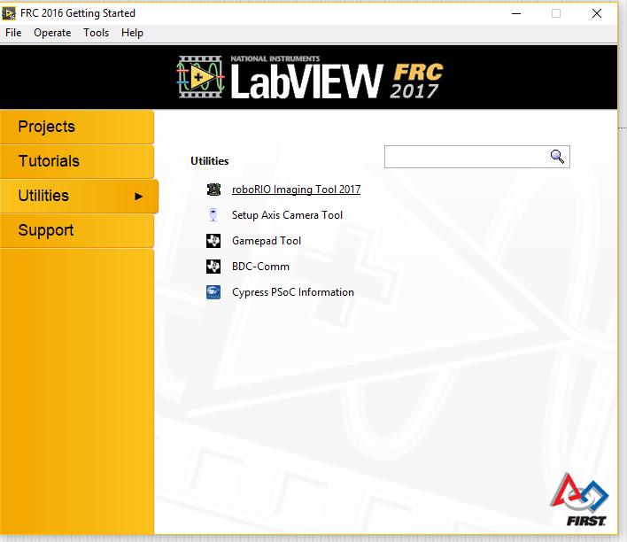
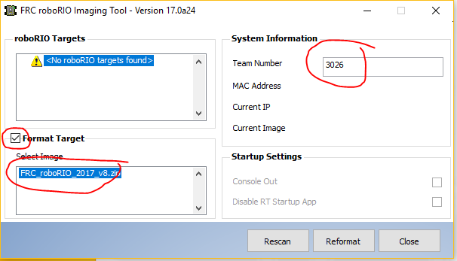
RoboRio Imaging Tool

Slide 11
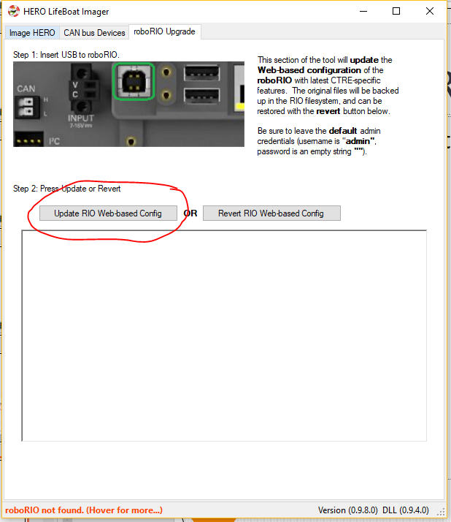
CTRE HERO Imaging Tool

Slide 12
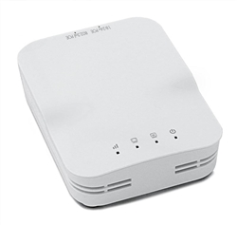
Radio

Slide 13
Facts about Radio
2 Ethernet slots
Runs on 12 V 1 Amp
Speed: 1.17 Gbps (300+867 Mbps)
Radio: 802.11b/g/n 2.4 GHz + 802.11a/n/ac 5 GHz
Antenna: Two internal dual band 2x2 (2.4 GHz) + 2x2 (5 GHz)
Range (approximate): 25-50’ indoor (1-2 walls) 100’ outdoor
Processor: 720 MHz QCA9557 + QCA9882 MIPS 74K
It sucks at connecting

Slide 14
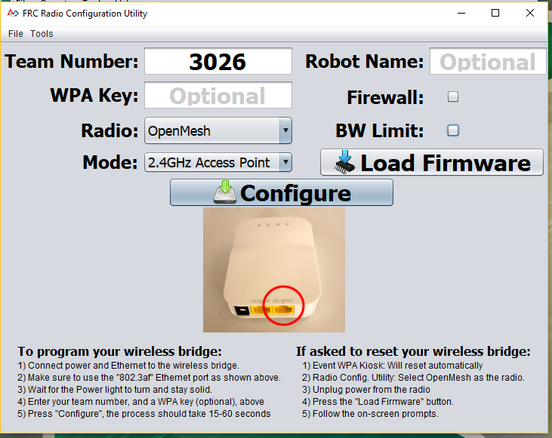
How to format a radio
FRC Radio Configuration Utility

Slide 15
Different Parts of a robot

Slide 16
Drive Train
This moves the robot around
6 CIMS
6 Talon SRX
Will be a combination of Tank drive and mecanum wheels
NavX will be used

Slide 17
Manipulator
Moves around game pieces
Includes and not limited to
Servos
Talon SRX
Variety of motors

Slide 18
Pneumatics
This is all of the air on the robot
Controlled by the PCM (Pneumatic Control Module)
Includes
Solenoids
PCM
Compressor
Transducer
We will be using pneumatics on all robots

Slide 19
What does this mean to me

Slide 20
You Need to know the hardware
You CAN NOT program a robot without knowing what you are programming
However you do not need to be a hardware expert
that's why we have a hardware team
Know all of the functions of all robot parts and there limitation

Slide 21
Examples
Amp limit on CIMS are 70 amps
DO NOT STALL 775 pros
The Talon SRX can do anything you want to
Trust me I've tried to find its limitation, it doesn’t exist
CIMS have a duty cycle of 5-7 minutes
Make sure solenoids are not fighting each other

Slide 22
Always set fail safes
You are the last defense between our robot and the driver
Ex:
2016 Arm can not go below ground level or above 90 degrees
2017 Robot when it climbs it goes into safe mode
Joystick 2 is disabled
All manipulator come inside of robot
Climber has an amp limit

Slide 23
Build and programming team vs Driver
When competition arrives drivers are told to drive it like you stole it
They will drive it to the breaking point and do anything to preform at their best
Make your program so they can get to that point but limits the robot before it breaks

Slide 24
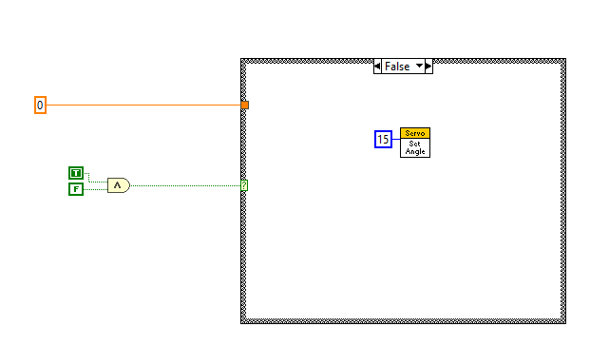
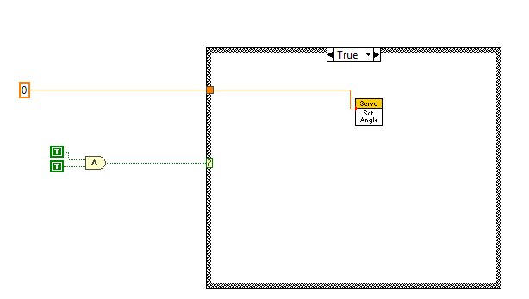
Example of failsafe
Fails test
Passes test

Slide 25
Lab 2
Write a VI with the following
Take a number off of a slider
Your code should accept values from 2-7
It should default to 5 if error occures
Any other number shoud be thrown out
Output should go to a numeric indicator
This code should run continusly
Hint: while loop

Slide 26
Turn In procedure
Upload VI into Extra VI’s folder
Name Lab 2

